Slide 1
Module 1: Lesson 2 – Conservational Tillage

Slide 2
Review of conventional tillage
What is the difference between Primary and Secondary Tillage?
Give one example of an implement used in primary tillage and one example of an implement used in secondary tillage

Slide 3
Review of conventional tillage

Slide 4
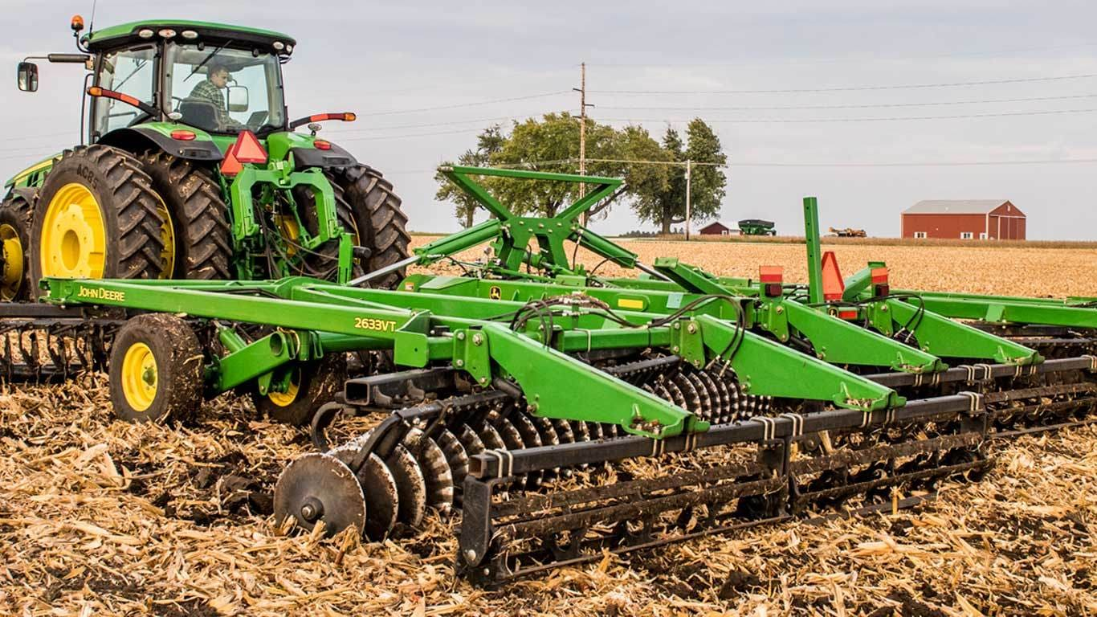
Vertical Tillage
Uses straight, shallow rolling blades to manage residue without turning over soil
Best used for preparing soil while keeping residue on the surface
Advantages: Reduces erosion while improving residue breakdown
Disadvantages: Does not address deep compaction layers
https://www.extension.iastate.edu/digitalag/video-benefits-using-vertical-tillage-tool

Slide 5
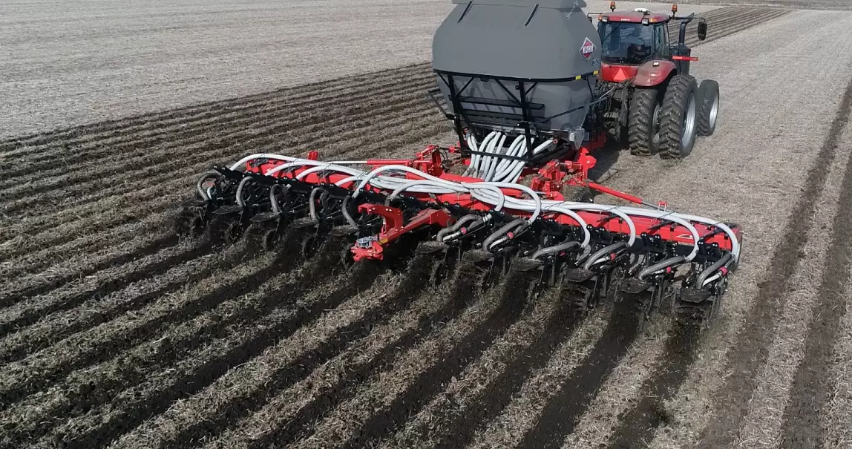
Strip-Till
Tills narrow strips while leaving most soil undisturbed
Best used for row crops like corn and soybeans and in fields with heavy residue
Advantages: Large portion of the soil undisturbed reduced runoff and soil loss, allows for precise placement of fertilizers
Disadvantages: specialized equipment can be expensive
https://www.youtube.com/watch?v=Iqwb1ZnzMLg

Slide 6
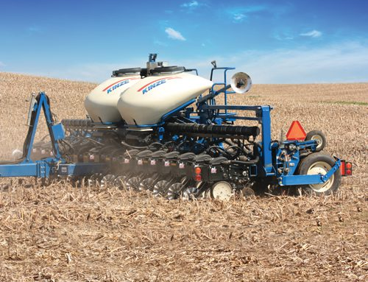
No-Till Planter/Drill
Plant seeds directly into untilled soil
Used in all major row crops in conservation farming
Advantages: Preserves soil moisture, less passes over the field saved fuel costs
Disadvantages: Residue buildup can slow plant emergence, may require herbicides for weed control
https://www.youtube.com/watch?v=eUX9c7n-QBM

